Slide 1
Customer Default Modelling
Tyro

Slide 2
Summery
Objective
A model to predict customer defaulting based on customer EFTPOS transactions
Solution
The suggested solution is an optimized classification model(XGBoost) with features include the customer recent behavior, i.e., considering the last N transactions.

Slide 3
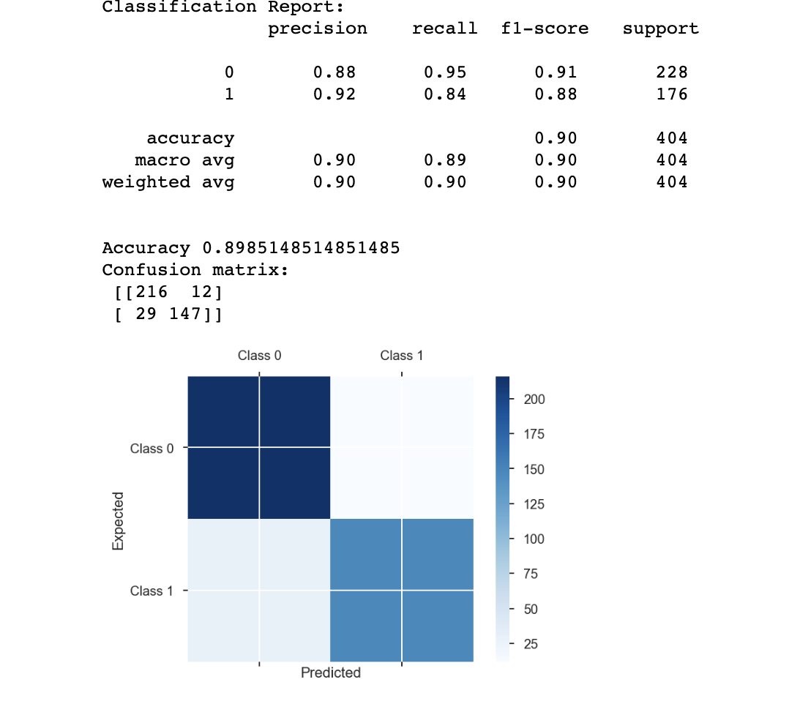
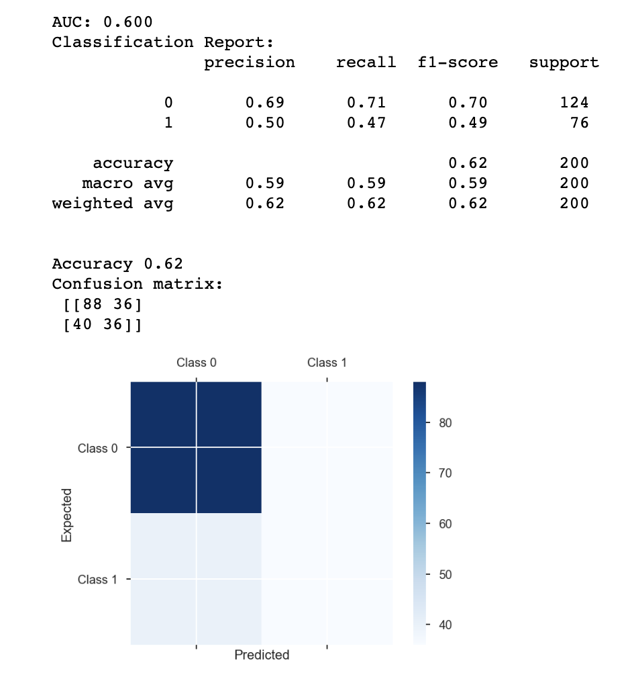
Result
The suggested solution is an optimized classification model(XGBoost) with features include the customer recent behavior, i.e., considering the last N transactions.
Location and industry features are on-hot encoded
Training
Testing

Slide 4
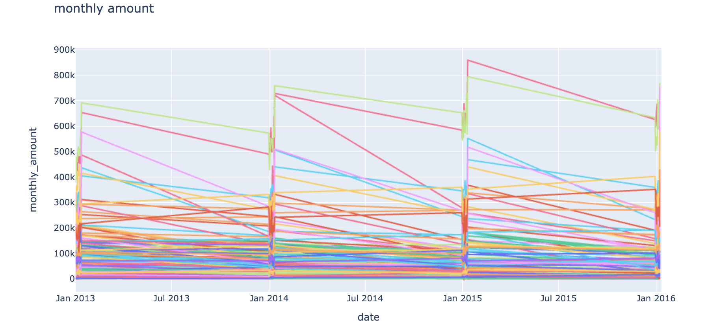
Expletory Data Analysis
The criteria to define a customer being defaulting is not clear
Data is given only for January of each year

Slide 5
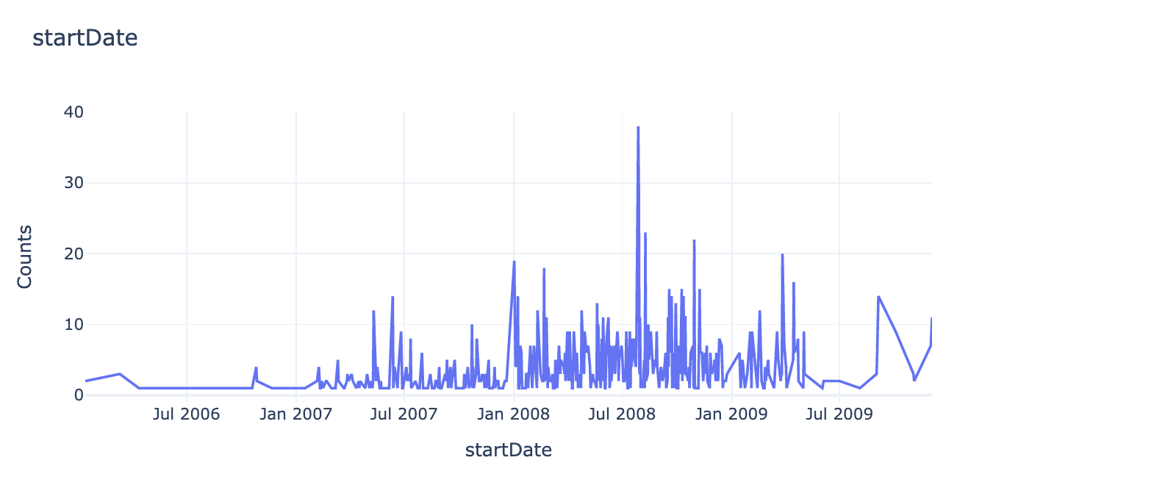
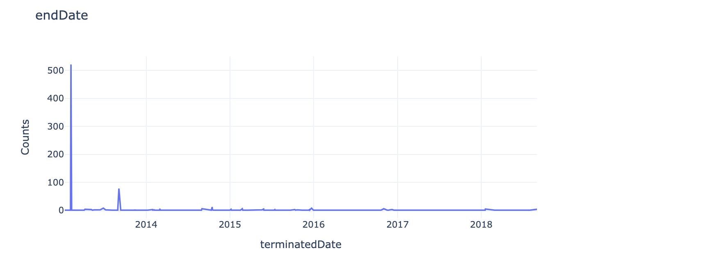
Expletory Data Analysis
Customer data: 'customer_id', 'startDate', 'firstTransactionDate', 'terminatedDate'
Transaction data: 'date', 'customer_id', 'industry', 'location', 'monthly_amount', 'daily_average_amount', 'daily_sd_amount'

Slide 6
Modelling
The task is formed as a classification problem based on XGBoost
Features:'date', 'customer_id', 'industry', 'location', 'monthly_amount', 'daily_average_amount', 'daily_sd_amount', 'startDate', 'firstTransactionDate', 'terminatedDate', 'Tenure', 'year', 'month', 'class', 'monthly_amount_1', 'daily_average_amount_1', 'daily_sd_amount_1', 'monthly_amount_2', 'daily_average_amount_2', 'daily_sd_amount_2', 'monthly_amount_3', 'daily_average_amount_3', 'daily_sd_amount_3', 'monthly_amount_4', 'daily_average_amount_4', 'daily_sd_amount_4’
The hypothesis is that recent money transactions impact customers
The hyperparameter of the model are optimized using Bayesian search
Other modeling could be tried as well. For example to consider the problem as time series.

Slide 7
Model interpretation

